Slide 1
Diabetes Predictor
🩺 AI101 Mini Project · Team No. 53
Predicting the likelihood of diabetes in patients based on age, BMI, blood glucose, HbA1c and medical history using logistic regression
Paras Raina
Lakkireddy Thulasiram Reddy
2026EEB1389
2026EEB1371
📊 PPT Lead
🎬 Video Lead
Manav Garg
Dhonnar Satyam Ramesh
2026MCB1543
2026AIB1031
📝 Documentation Lead
💻 Execution Lead
🔗 Repo: github.com/Paras-Raina/AI101-Mini-Project

Slide 2
🔎 Problem and data
🎯 What and why
🗂️ Dataset
Classify whether a patient has diabetes from age, BMI, blood glucose, HbA1c, hypertension and heart disease.
Kaggle: Diabetes Prediction Dataset (iammustafatz)
9 columns: gender, age, hypertension, heart_disease, smoking_history, bmi, HbA1c_level, blood_glucose_level and diabetes (target).
Diabetes often goes unnoticed, so a simple, explainable model can flag high-risk patients for proper testing.
We use 6 as inputs and leave out gender and smoking history.
100,000
96,146
8.8%
📄 raw rows
🧹 rows after removing 3,854 duplicates
🩸 diabetic records (imbalanced)
Dataset: https://www.kaggle.com/datasets/iammustafatz/diabetes-prediction-dataset

Slide 3
⚙️ Approach
📥 Data
🧹 Clean
🛠️ Prepare
🤖 Model
📊 Output
Kaggle CSV, 100,000 rows
No missing values; 3,854 duplicates dropped
6 features, 80/20 stratified split, StandardScaler
Logistic Regression (max_iter = 1000)
Diabetes yes or no, scored by accuracy, precision, recall, F1
→
→
→
→
📚 Libraries used
pandas · NumPy · Matplotlib · Seaborn · scikit-learn
Train set: 76,916 rows · Test set: 19,230 rows

Slide 4
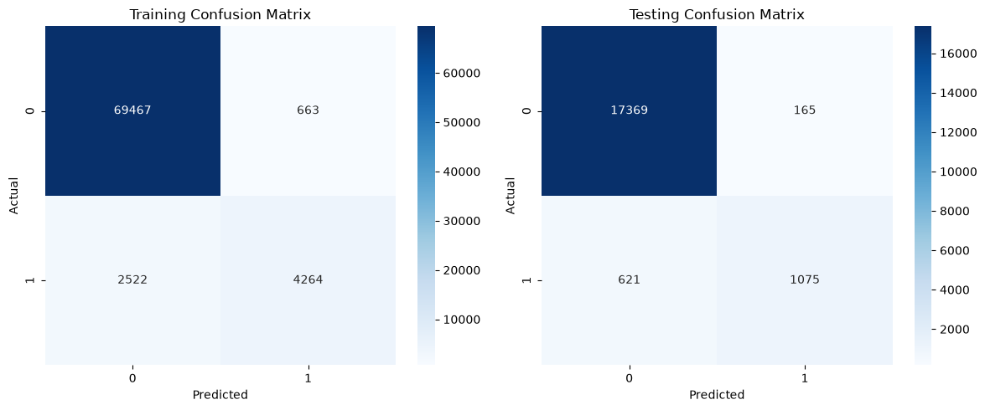
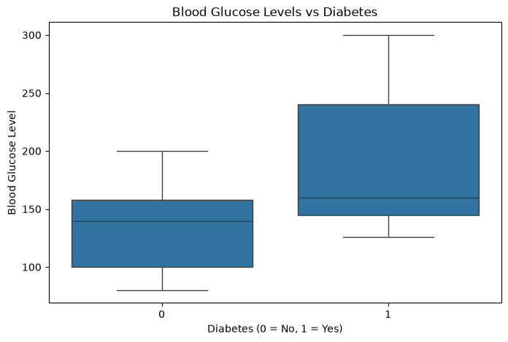
📈 Results
Confusion matrices: train (left), test (right)
Blood glucose is higher in diabetic patients
95.91%
86.69%
63.38%
73.23%
✅ Test accuracy
🎯 Test precision
🩺 Test recall
⚖️ Test F1-score
Share of all patients classified correctly
When we predict diabetes, how often we are right
Share of actual diabetic patients we catch
Balance between precision and recall

Slide 5
💡 Learnings
✅ What worked
⚠️ What didn’t
👥 Who did what
95.91% test accuracy
86.69% test precision: most patients flagged as diabetic really were
Train and test scores almost identical, so no overfitting
HbA1c and blood glucose are the strongest predictors
Recall is only 63.38%: 621 of 1,696 diabetic test patients were missed
Accuracy is flattered by imbalance (8.8% diabetic)
To try: class weights or a lower threshold
📊
Paras Raina
PPT Lead · Data pre-processing and cleaning
🎬
Lakkireddy Thulasiram Reddy
Video Lead · Model training
Manav Garg
📝
Documentation Lead · Checked other evaluation metrics (precision, F1-score)
Dhonnar Satyam Ramesh
💻
Execution Lead · Tested the model and added the box plot
🤖 AI-use disclosure
Claude: Generated the slides the way we wanted them
ChatGPT: Helped plot heat maps and write the final analysis

